Slide 1

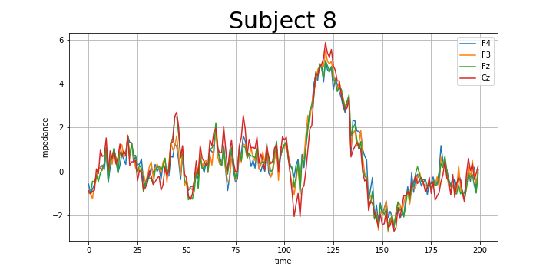
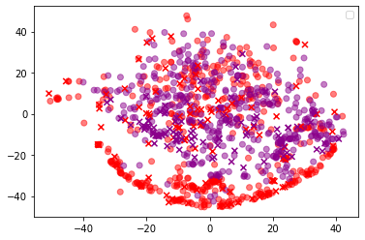
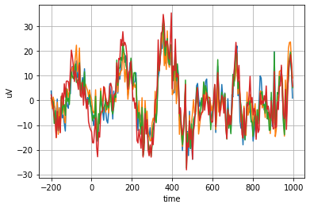

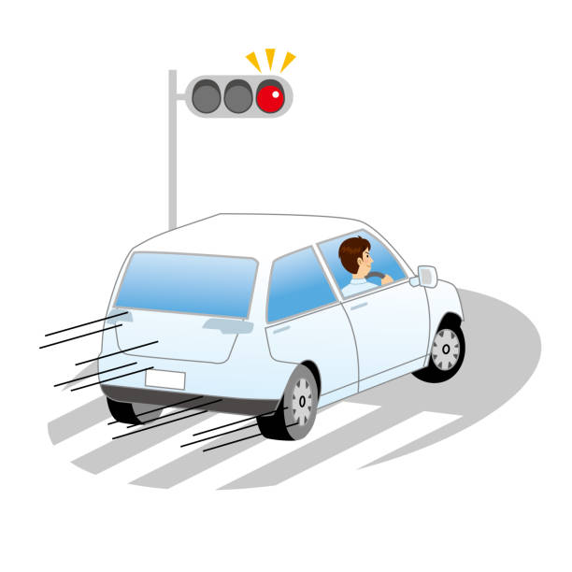
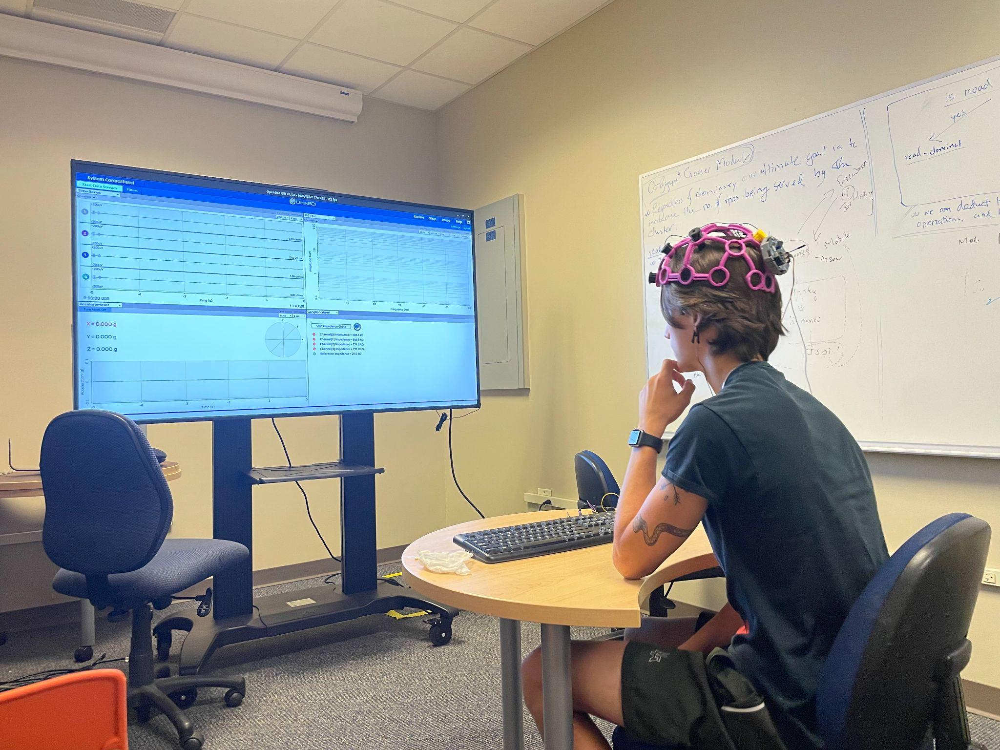
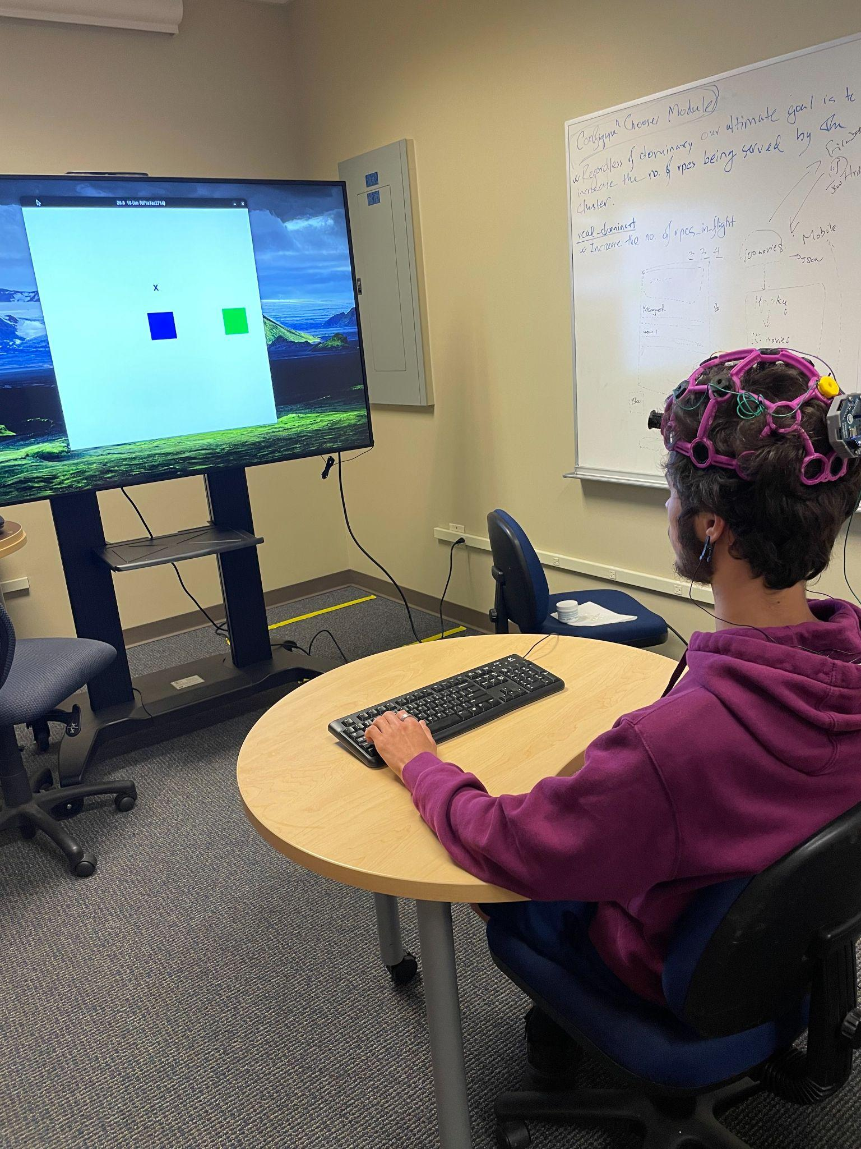
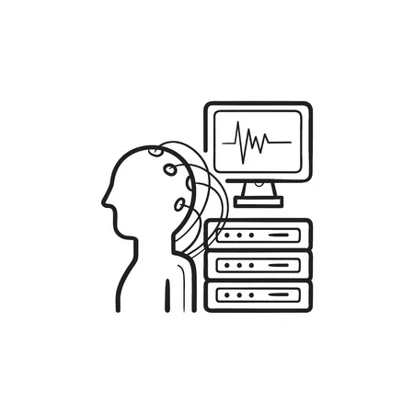

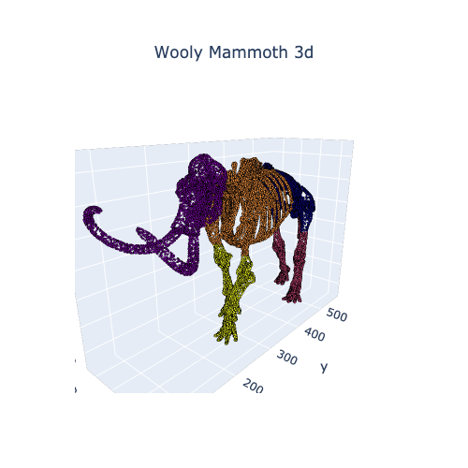
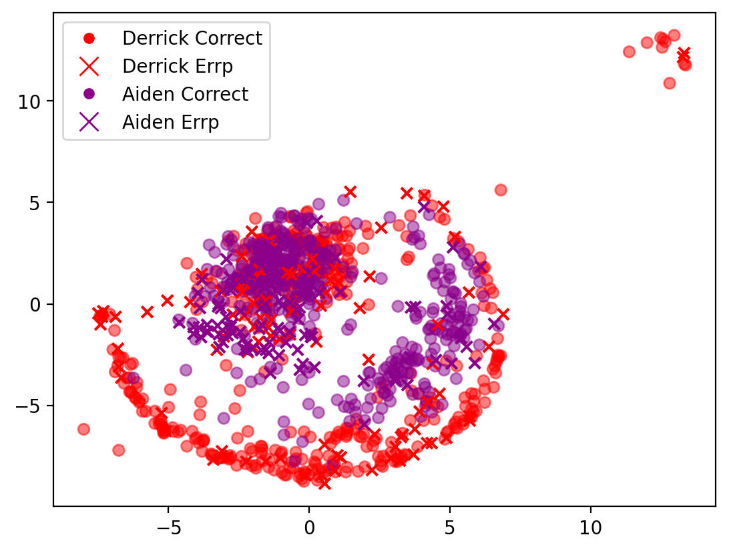
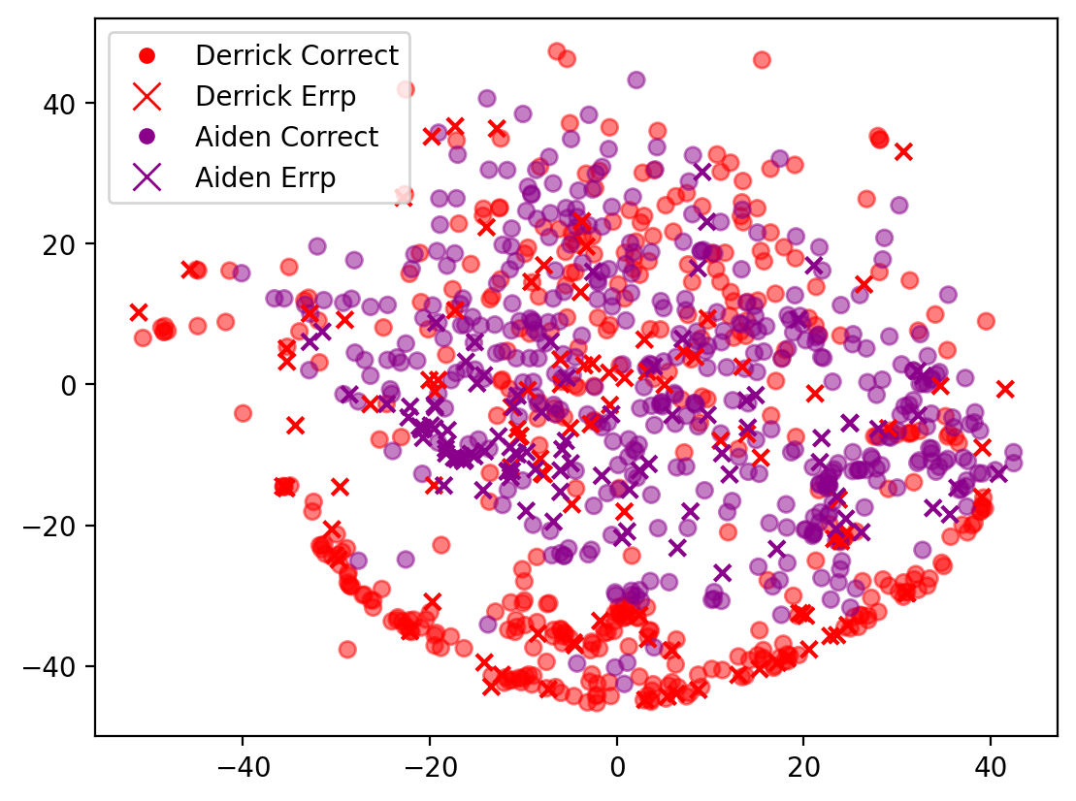
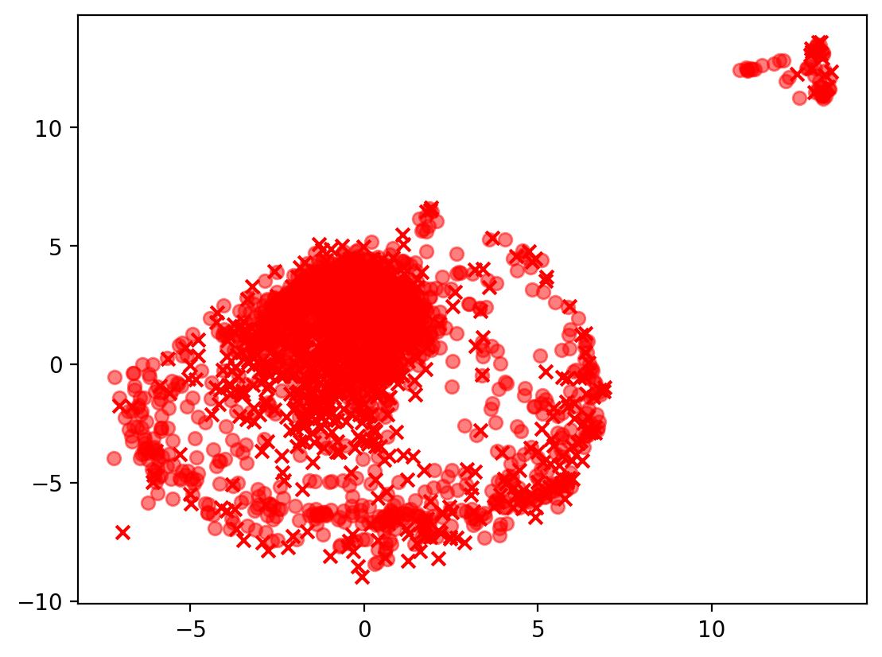
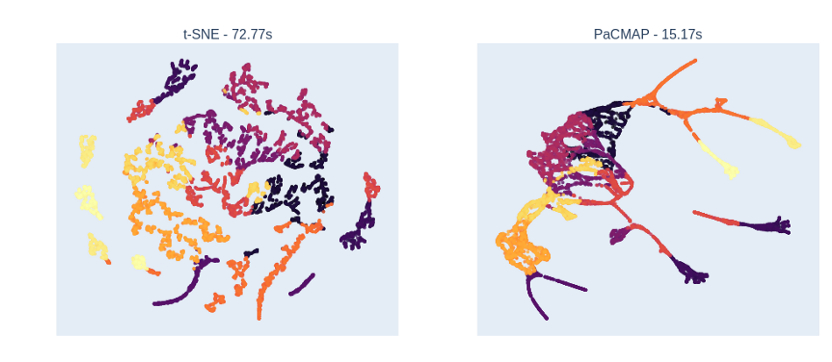
How Does My Brain Compare to (A)?
Derrick Mayall, UNC Charlotte
Dr. Jake Lee, Computing Informatics
Problem
Method
Devices being controlled by the brain have been researched for a long time and still have a long ways to go. One issue with these devices is how a person’s brain signal may differ from others, so the same device will not work for everyone. This makes it difficult to not only commercialize these products but also makes it hard to develop these products at all.
Visualize processed data of two subjects
Subject2:
Reduce Dimensions of the Data
Visualizing Reduced Data and Comparing
Subject1:
How are they similar?
Process Data
Subject 1
Subject 2
Subject1
Gathering Data With EEG
Subject2
Reduction Process
Preliminary Results
All Visuals On Computer
Get Data You Wish To Reduce (The more the better):
This figure shows the data between me and aiden after being reduced by PaCMAP across all epochs and labels.
This figure shows the data between me and Aiden after being reduced using t-SNE across all epochs and labels.
This figure shows the data for subject 3 after being reduced by PaCMAP across all epochs and labels.
Derrick And Aiden PaCMAP
Derrick And Aiden t-SNE
Subject 3 PaCMAP
Run Data Through Dimensionality Reduction Algorithm (This 3D graph is going to a 2D form)

